Slide 1






PRESENTATION
Azure-basedCar Sales AnalyticsProject
Complete Data Pipeline, SQL Analysis & Power BI Dashboard
Author:Mahdi Makhloufi
Date:September 2025

Slide 2













Project Overview
Project Objective
Extract actionable insights from raw car sales data to support critical decisions related to inventory management, marketing strategies, and overall sales performance.
Project Workflow
Data Ingestion
Data Transformation
SQL-based Analysis
Visualization & Insights
Raw data collected and stored in Azure Blob Storage
Processing using Azure Data Factory or Databricks with Spark
Cleaned data analyzed using SQL queries in Azure Data Studio
Interactive Power BI Dashboard for data exploration
Key Highlight:This approach emphasizes an end-to-end solution, offering flexibility with two distinct ETL options to cater to varying data processing needs.
Azure-based Car Sales Analytics Project

Slide 3
















ETL Pipeline – Azure Data Factory
Azure Data Factory
Azure Data Factory (ADF) automates the Extract, Transform, Load (ETL) process for car sales data. This low-code solution efficiently handles repetitive data integration tasks, ensuring structured and clean data is consistently available for analysis.
ADF Pipeline Process Flow
Ingestion
Transformation
Loading
Orchestration
CSV data ingested from Azure Blob Storage
Filtering, sorting, and renaming columns to standardize data
Transformed data loaded into Azure SQL Database (CarSaless)
Pipeline runs scheduled and monitored within ADF
Low-code solution:Reduces development time for repetitive ETL tasks
Data freshness:Automated pipeline ensures up-to-date analytics
Azure-based Car Sales Analytics Project

Slide 4












ETL Pipeline – Databricks & Spark
Advanced ETL Option
For more advanced and large-scale data processing, an alternative ETL pipeline leverages Azure Databricks with Apache Spark. This approach is particularly suited for complex transformations and handling extensive datasets, offering robust capabilities for data cleaning and trend extraction while ensuring secure data handling.
PySpark-based ETL Process
Data Reading
Cleaning & Normalization
Trend Extraction
Data Loading
The car_data.csv file is read into a Spark DataFrame using PySpark
Complex transformations to identify top-selling models and analyze transmission trends
Processed data is securely loaded into Azure SQL Database using JDBC connectivity
Data undergoes cleaning processes such as removing duplicates and enriching existing data points
Advanced:Suitable for large-scale datasets
Features:Complex transformations & trend extraction
Security:Credentials managed via secrets vault
Azure-based Car Sales Analytics Project

Slide 5



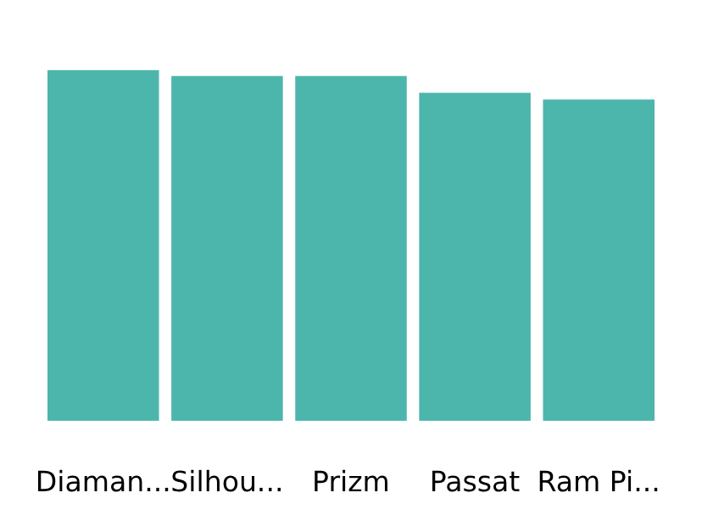








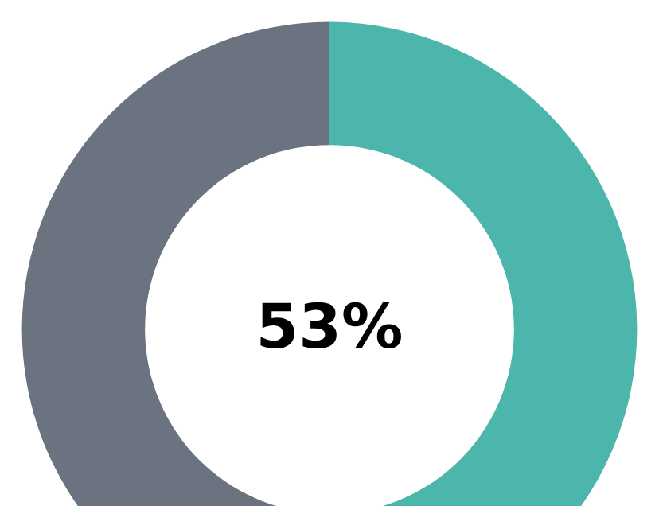





SQL Analytics – Azure Data Studio
R1 – Top 5 Best-Selling Models
R2 – Average Price by Model
Diamante:4,180 units
Silhouette:4,110 units
Prizm:4,110 units
Passat:3,910 units
Ram Pickup:3,830 units
20% of models generate ~80% of sales
Entry-level
Mid-range
Premium
< $20,000
$20,000-35,000
> $40,000
Mirage, Escort, Sentra
Accord, Corolla, Camry
Catera, LS400
Top sellers: $22,000-29,000
R3 – Transmission Distribution
R4 – Body Style Distribution
Automatic: 53%
Manual: 47%
SUVs + Hatchbacks
Sedans
> 50% of sales
$29,800 avg price
Azure-based Car Sales Analytics Project

Slide 6




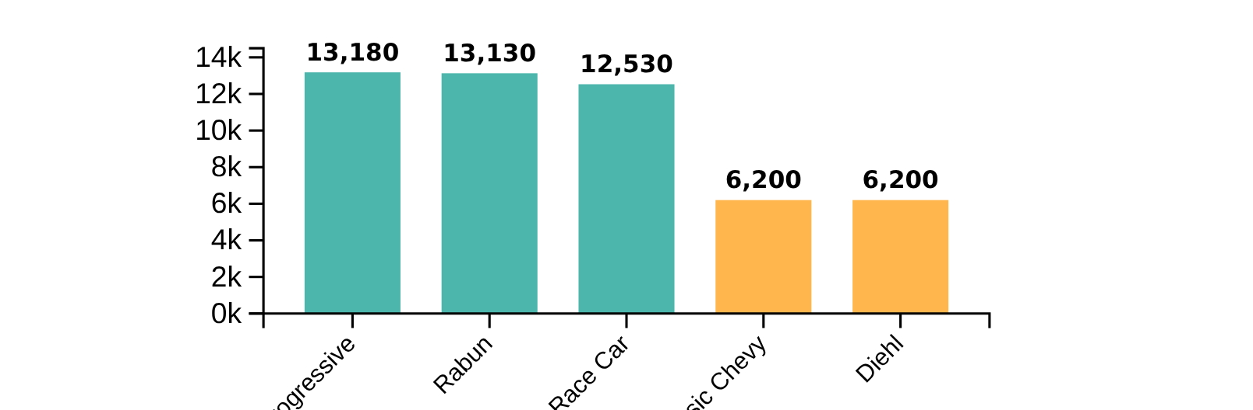
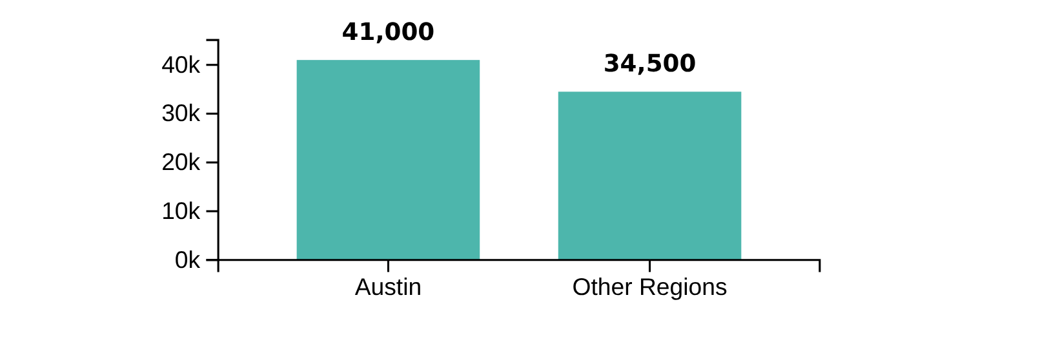
Dealer & Regional Insights
Regional Analysis
Dealer Performance
Key Regional Insights:
Key Dealer Insights:
Austin leads in sales volume with41,000 unitsand avg. price of ~$28,300
Top performers show similar sales volumes (13,000-13,500 units)
Smaller dealers (Classic Chevy and Diehl) show ~6,200 units
Other regions show comparable sales: 31,000-38,000 units
Volume leaders likely have better market influence and potential for partnerships
Regional differences driven primarily bysales volumerather than price
Dealer Performance
Sales by Region
Key Insight:Regional sales volumes vary significantly while price points remain relatively consistent. This suggests market penetration strategies should focus on volume expansion rather than price differentiation.
Azure-based Car Sales Analytics Project

Slide 7


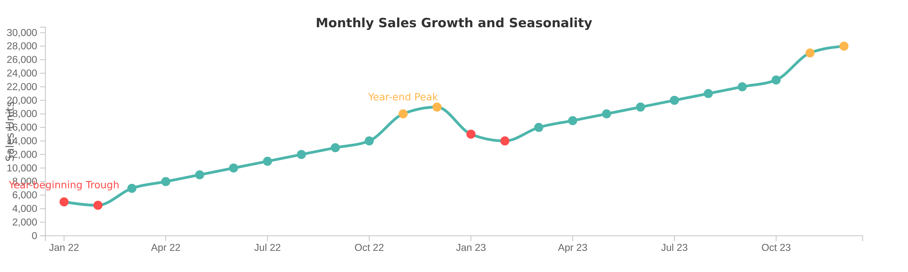




Sales Trends Over Time
Analysis of monthly sales from January 2022 to December 2023 reveals significant market expansion and recurring seasonal patterns.
Market Growth
Seasonal Patterns
Sales units increased from 3,000–8,000 units/month in early 2022 to approximately 19,000 units/month by late 2023, representing a six-fold growth.
Sales typically peak in November and December, with troughs in January and February. Average price remains stable at 26,700-29,000 USD.
Business Implications
A strategic focus on year-end promotions could further capitalize on peak demand during November and December. Understanding seasonal patterns enables better inventory management and marketing strategies throughout the year.
Azure-based Car Sales Analytics Project

Slide 8




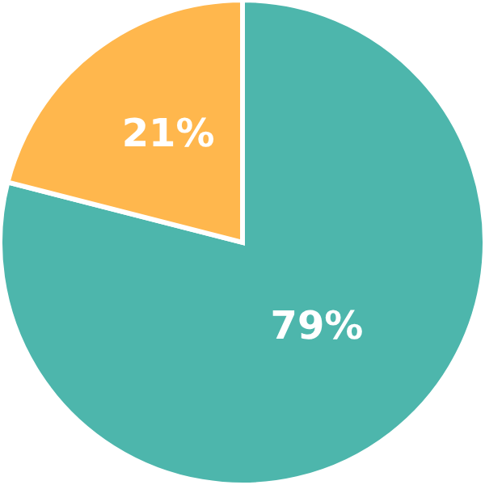
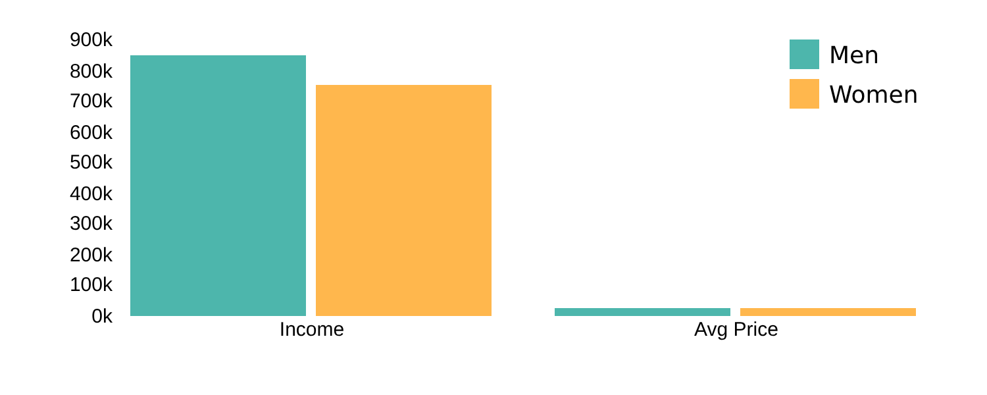



Customer Profile
Analysis of customer demographics reveals distinct segments with different purchasing behaviors.
Gender Distribution
Average Income & Price Paid by Gender
Key Insight
Marketing Strategy
Women pay slightly more despite lower income, indicating a preference for premium or better-equipped models.
Target women for high-value models to leverage their preference for premium vehicles.
Azure-based Car Sales Analytics Project

Slide 9

























Power BI Dashboard
Interactive Dashboard
The Power BI Dashboard serves as the interactive front-end for the car sales analytics project, transforming complex data into easily digestible visuals.
Car Sales Dashboard
Filters
Total Sales
Average Price
Revenue
Car Model
41,000
$28,300
$1,166,300
Key Performance Indicators
Select models...
Total Sales, Average Price, Revenue
Top Selling Models
Transmission Distribution
Brand
Select brands...
Interactive Charts
Region
Sales by Brand, Transmission Type, Monthly Trends
Select regions...
Date Range:
Jan 2022 - Dec 2023
Dynamic Filters
By Car Model, Brand, Region, and Time Period
Empowers stakeholders to gain deeper insights and respond proactively to market dynamics.
Azure-based Car Sales Analytics Project

Slide 10
















Key Business Insights
The car sales data has revealed several critical insights that can guide business strategy:
Dominant Models
Price Segmentation
Diamante, Silhouette, and Prizm are high-volume models
Market divided into Entry-level (<20k), Mid-range (20-35k), Premium (>40k)
These affordable models show strong market demand
Top sellers in mid-range segment (22-29k USD)
Body Style Preferences
Dealer Performance
SUVs and Hatchbacks drive sales volume
Top performers: Progressive (13,180), Rabun (13,130), Race (12,530)
Sedans generate higher revenue (avg 29.8k USD)
Small dealers can command higher prices
Customer Behavior
Seasonality
Gender split: 79% male, 21% female
Clear seasonal patterns in sales
Women pay slightly more (28,277 vs 28,039 USD)
Year-end (Nov-Dec) shows highest sales
Impact:These insights can guide inventory management, marketing strategies, and sales approaches to maximize business performance.
Azure-based Car Sales Analytics Project

Slide 11
















Tools & Technologies
Azure Technology Stack
The Azure-based Car Sales Analytics Project leveraged a robust stack of Microsoft Azure services and related technologies to build a comprehensive data pipeline and analytics solution.
Azure Blob Storage
Azure Data Factory
Azure Databricks
Used for hosting raw CSV data, serving as the initial entry point for the analytics pipeline.
Employed for low-code ETL processes, automating the data integration tasks for efficient data processing.
Utilized for advanced transformations with Spark, handling complex data processing tasks.
Azure SQL Database
Azure Data Studio
Power BI
Served as the centralized repository for querying structured data, providing persistent storage for processed data.
Provided the environment for SQL analytics, enabling complex queries and insights extraction from the data.
Enabled the creation of interactive dashboards for visualization, transforming data into actionable business insights.
Integrated Solution:These tools work together to create an end-to-end data pipeline, from raw data ingestion to actionable insights, providing a comprehensive analytics solution for car sales data.
Azure-based Car Sales Analytics Project

Slide 12



















Challenges & Solutions
Throughout the project, several challenges were addressed with effective solutions to ensure successful implementation of the Azure-based car sales analytics solution.
Challenges
Solutions
Handling large datasets efficiently
Distributed computing with Spark
Processing and analyzing large volumes of car sales data required specialized approaches to maintain performance.
Leveraged Azure Databricks with Apache Spark for distributed data processing, enabling efficient analysis of large datasets.
Ensuring data quality
Validation checks at each pipeline stage
Raw car sales data often contains inconsistencies and errors that can skew analysis results and insights.
Implemented quality controls throughout the ETL pipeline to ensure data consistency and accuracy.
Extracting actionable insights
SQL + Power BI for structured analysis
Transforming raw data into meaningful business insights requires structured analysis and visualization approaches.
Combined structured SQL queries with interactive Power BI dashboards to transform data into actionable business insights.
Key Insight:The successful implementation of this end-to-end pipeline has provided valuable insights into sales trends, customer behavior, and dealer performance.
Azure-based Car Sales Analytics Project

Slide 13













Future Enhancements
To further enhance the project's capabilities and extend its value, several future enhancements are planned:
Short-term
Mid-term
Long-term
Future
Real-time Data Streaming & Analytics
Predictive Modeling for Sales & Pricing
Implement capabilities for processing and analyzing data as it arrives, enabling immediate insights without batch processing delays.
Develop models to forecast sales trends and optimize pricing strategies based on historical data patterns and market factors.
Expanded Dashboard Filters and KPIs
Security & Role-based Access in Power BI
Add more granular filtering options and key performance indicators to the Power BI dashboard for deeper data exploration.
Enhance data security and access control within the Power BI environment to support different user roles and data sensitivity levels.
These enhancements will further strengthen the project's capabilities, providing more timely and insightful analytics to support business decision-making.
Azure-based Car Sales Analytics Project

Slide 14





















Conclusion
The Azure-based Car Sales Analytics Project successfully implemented an end-to-end data pipeline, transforming raw car sales data into actionable business insights.
Data Pipeline
SQL Analytics
Interactive Dashboard
Implemented robust ETL processes using Azure Data Factory and Databricks with Spark, establishing a reliable data foundation.
Extracted valuable insights through structured SQL queries, uncovering key trends in sales performance, customer behavior, and market dynamics.
Developed an interactive Power BI dashboard enabling stakeholders to explore data and make informed business decisions.
Raw Data Ingestion
Data Transformation
SQL Analysis
Power BI Dashboard
Actionable Insights
This project demonstrates how an integrated Azure ecosystem can transform raw data into actionable business insights, enabling data-driven decision making.
Azure-based Car Sales Analytics Project

